Slide 1
ENED1120: Foundations of Engineering Design Thinking II
Day 11.1
Sequential Flow in Visual Basic for Applications

Slide 2
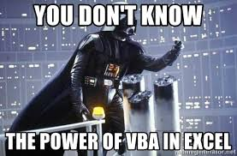
Outline
Announcements
VBA Sequential Flow
Review of basic syntax
Example
Activity
CFU 10.2

Slide 3
Announcements
See Canvas
https://uc.instructure.com/courses/1744110/discussion_topics/9731890

Slide 4

Questions?
Questions?

Slide 5

General Things to Remember about VBA
You cannot write macros in the online version of Excel, so you will need to download and install it to your computer
You can find instructions for installing Microsoft Office though the UCIT website: Link to KB Article about Office 365
Once you add in a macro to an Excel file, you will need to save it as a .xlsm file rather than a .xlsx file
Failure to change the file extension may result in the loss of your code

Slide 6
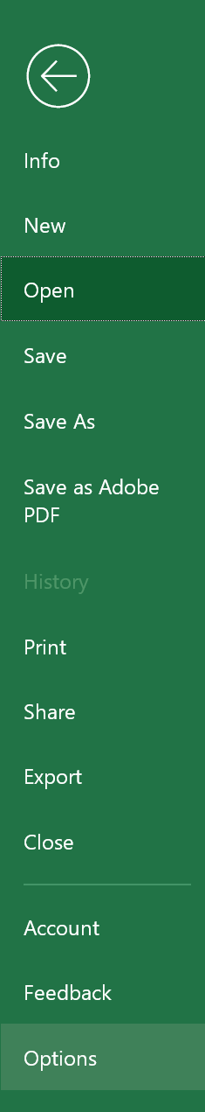
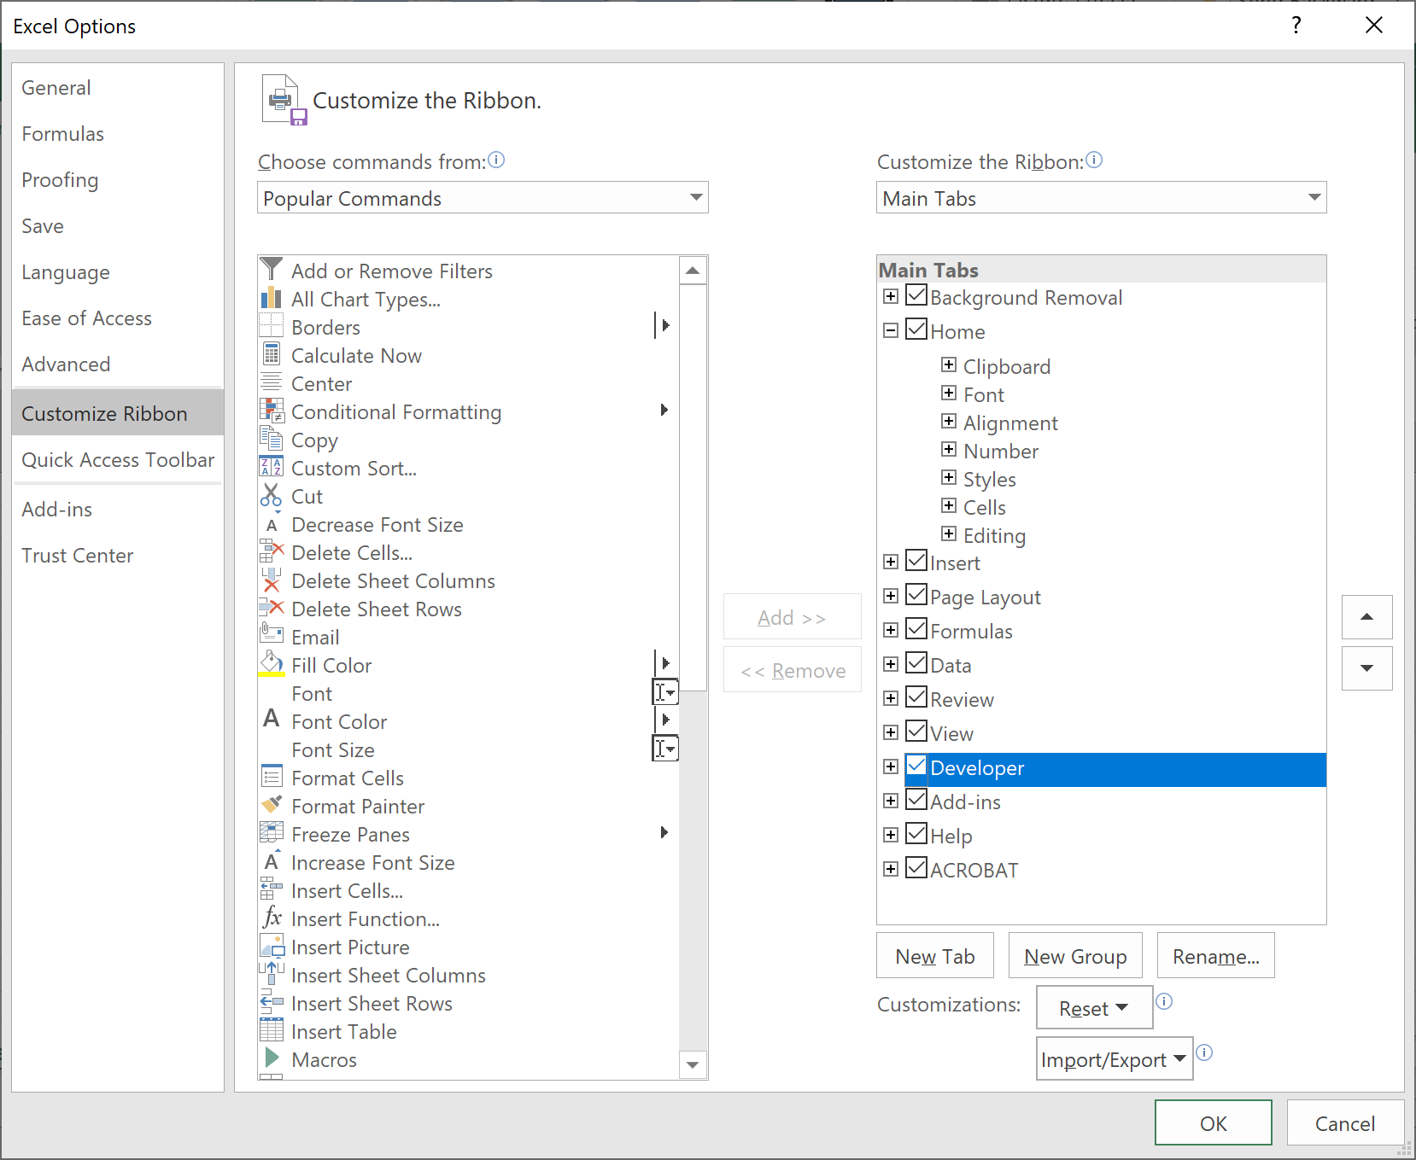
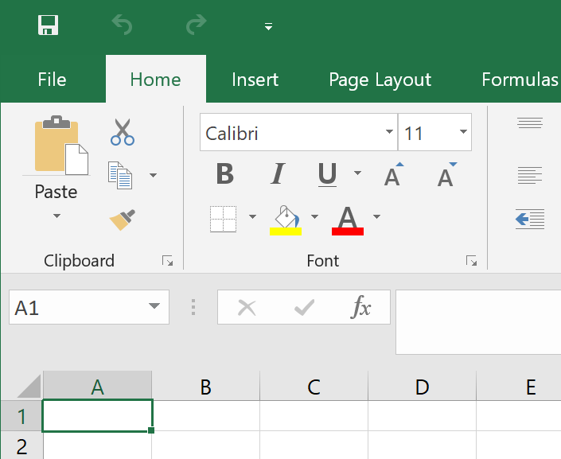
General Things to Remember about VBA
To open the VBA editor in Excel, you must first add the Developer tab to the ribbon
1
3
4
5
2

Slide 7
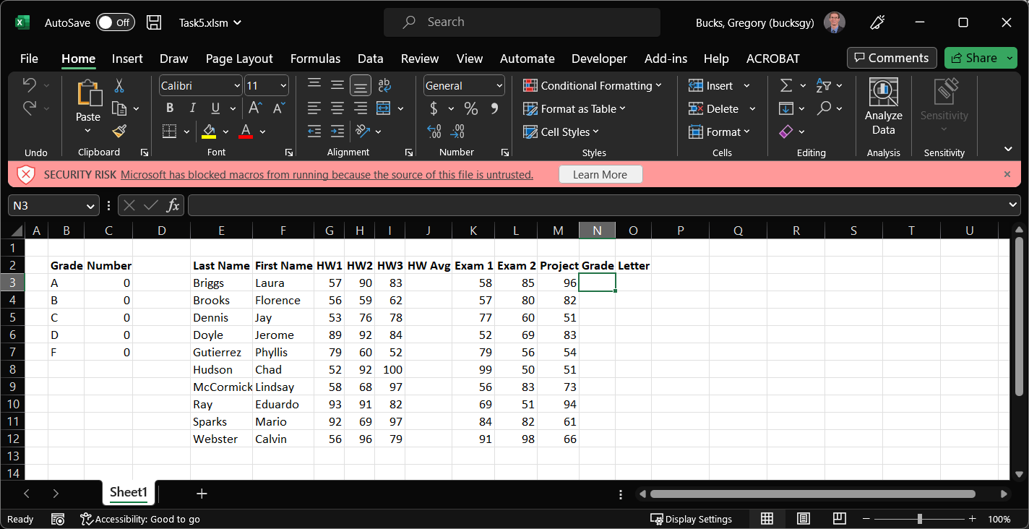
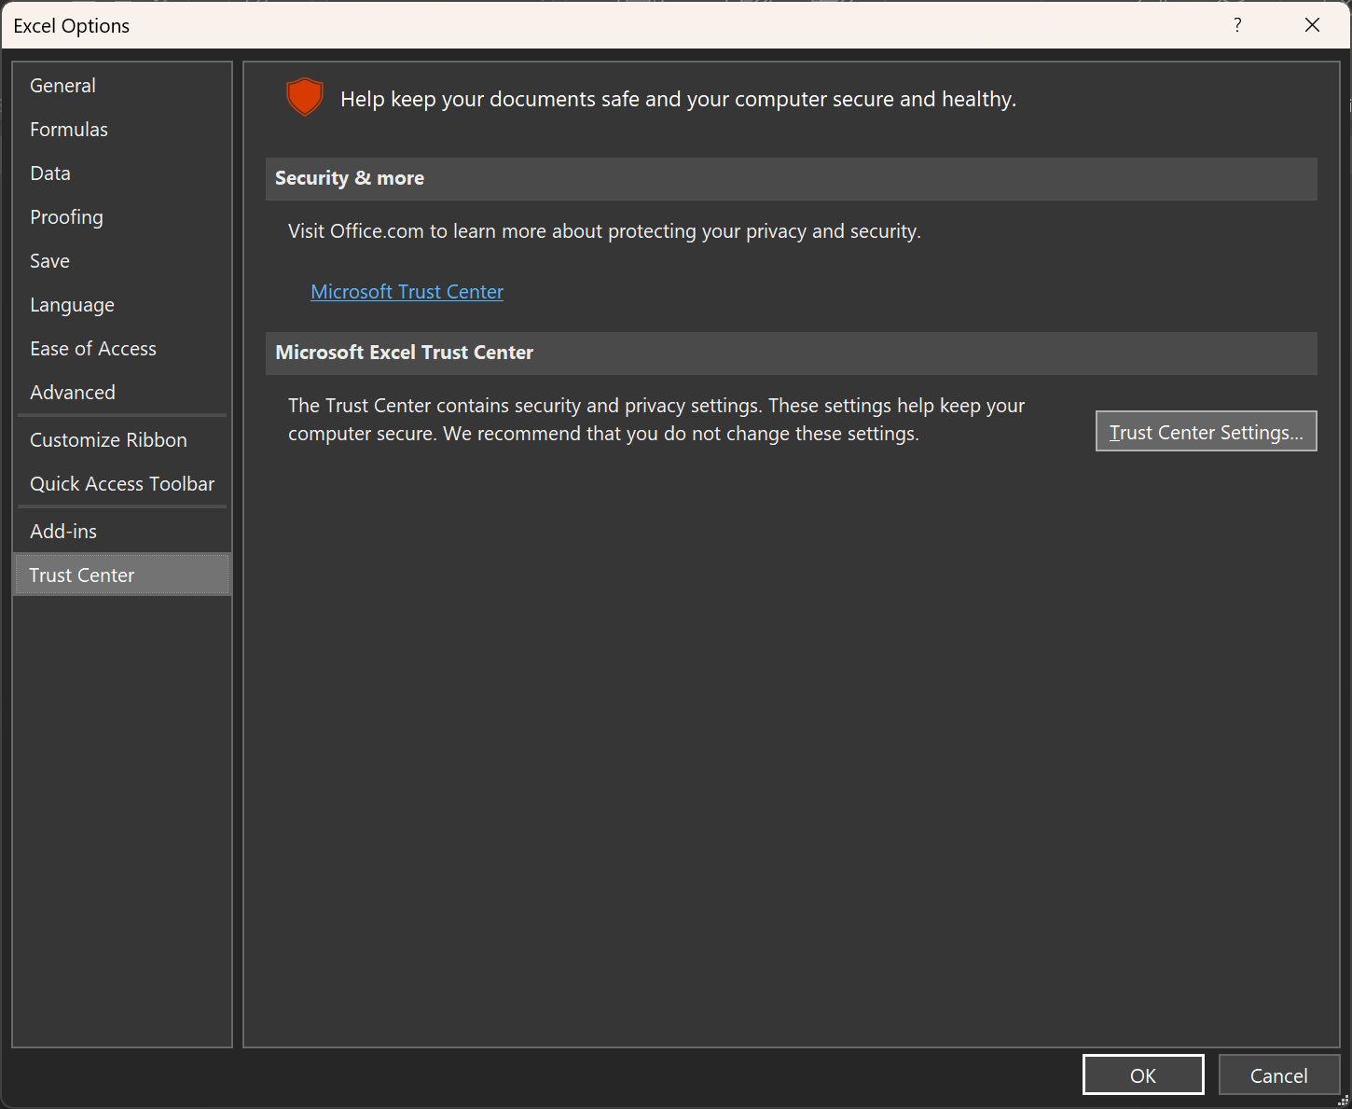
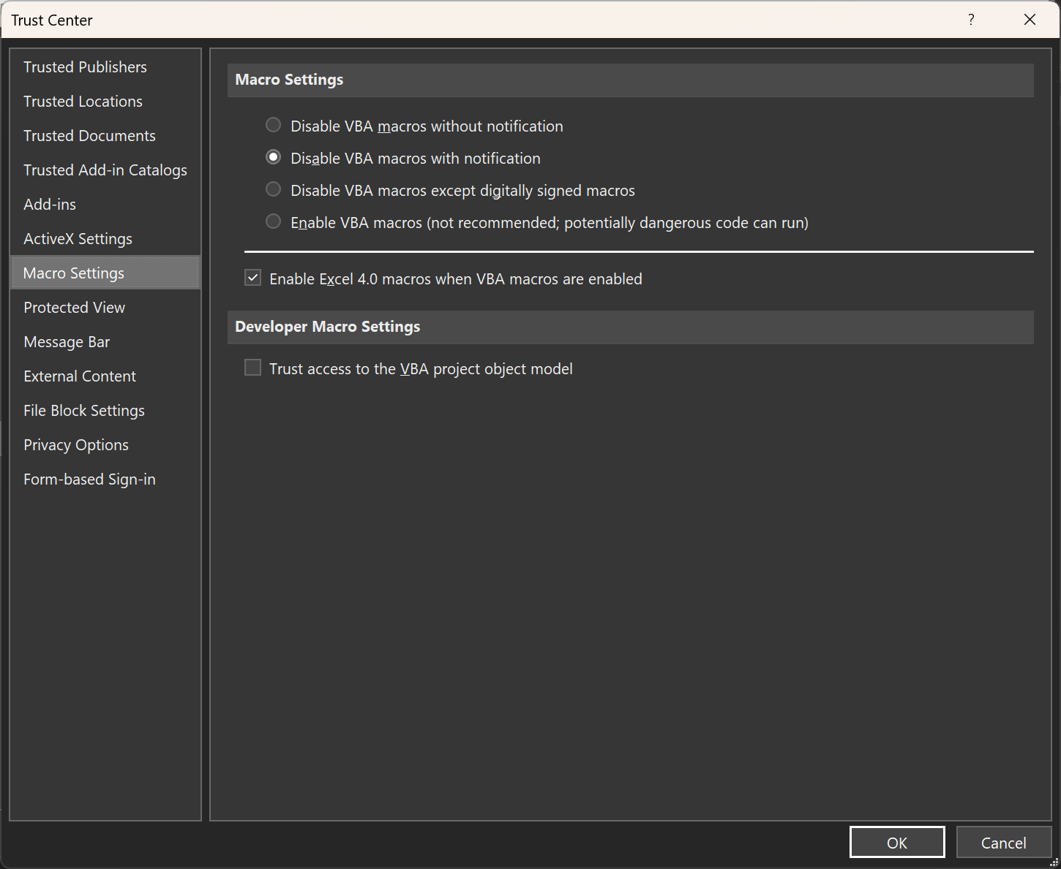
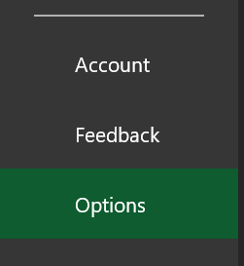

Issues Opening Macro Files
Occasionally, you may run into an issue trying to open an Excel file containing a Macro and will receive the following:
If you receive this message, there are two things to check:
Update your Security settings within Excel
From File Menu

Slide 8
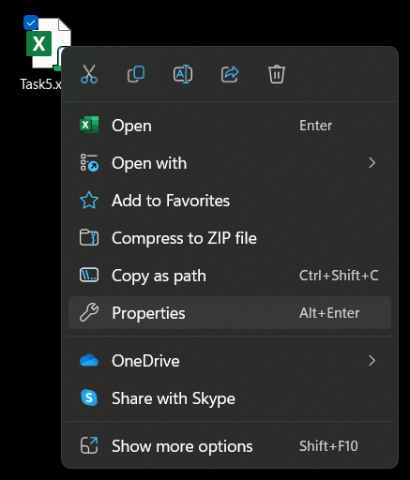
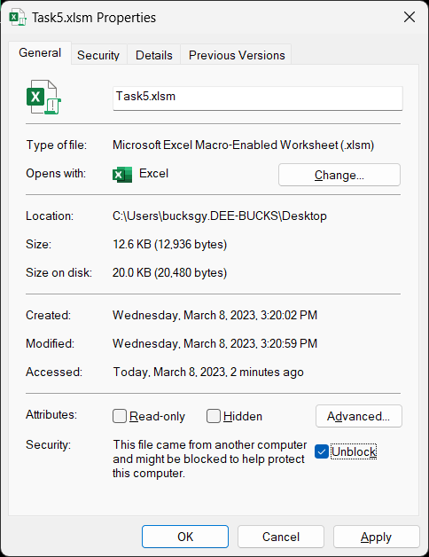
Issues Opening Macro Files
Occasionally, you may run into an issue trying to open an Excel file containing a Macro and will receive the following:
If you receive this message, there are two things to check:
Change the settings on the file
Right click on file

Slide 9
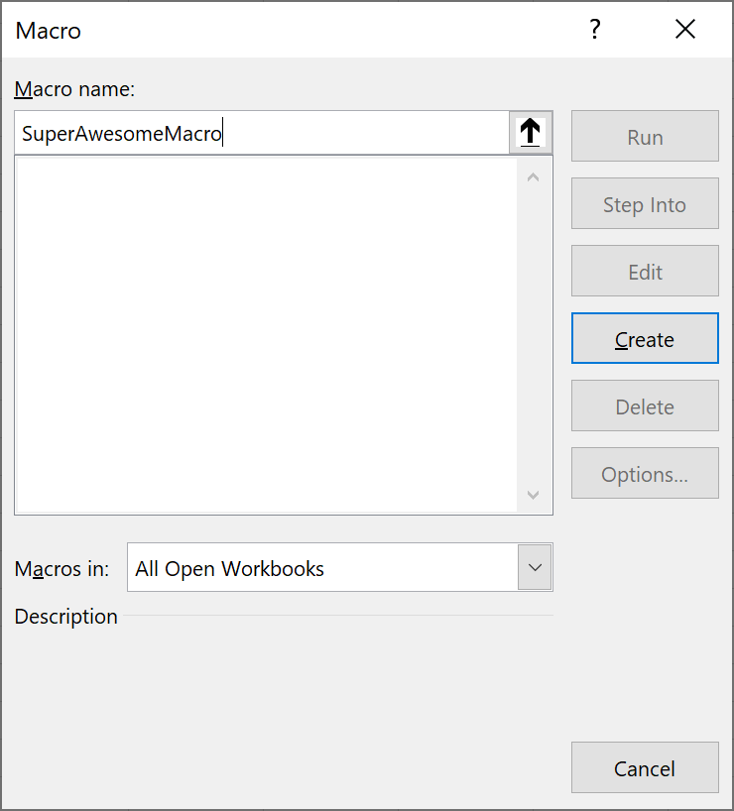
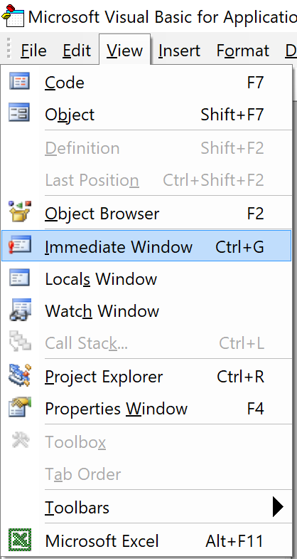
General Things to Remember about VBA
To start creating a macro from scratch, first create the macro using the Macros button in the Developer tab; once created the VBA Editor will automatically open so you can begin writing your macro code
If you’re going to use the Debug.Print command to display anything while your code is running, make sure you have your Immediate Window open and visible

Slide 10
Syntax Summary
Common Variable Types: Integer – whole numbers in the range -32,768 to 32,767
Long – whole numbers in the range -2,147,483,648 to 2,147,483,648
Double – decimal numbers
String – single characters or text
Declaring a variable: Dim Var As VariableType
Reading from or writing to an Excel Cell: ActiveSheet.Cells(R,C).Value
Using an Excel formula command in VBA: WorksheetFunction.Function(args) i.e. WorksheetFunction.Pi() WorksheetFunction.Average(x)
Starts at 1!

Slide 11
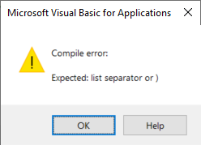
Syntax Summary: Basic Mathematical Operators
Operation | VBA | MATLAB | Python
Power | ^ | ^ | **
Multiplication | * | * | *
Division | / | / | /
Integer Division |  |  | //
Modulus | Mod | mod() | %
Addition | + | + | +
Subtraction | - | - | -
High Precedence
Medium Precedence
Low Precedence
*Note: for the power operator in VBA, you must have a space between the value and the operator; otherwise, you will receive an error message
e.g. y = x ^ 2

Slide 12
Syntax Summary: Advanced Mathematical Functions
In addition to basic mathematical operators, VBA has some additional commonly used mathematical functions:
Abs() Absolute value
Atn() Inverse tangent of the argument (in radians)
Cos() Cosine of the argument (in radians)
Exp() e raised to the power of the argument
Log() Natural logarithm of the argument
Sin() Sine of the argument (in radians)
Tan() Tangent of the argument (in radians)
Sqr() Square root of the argument

Slide 13
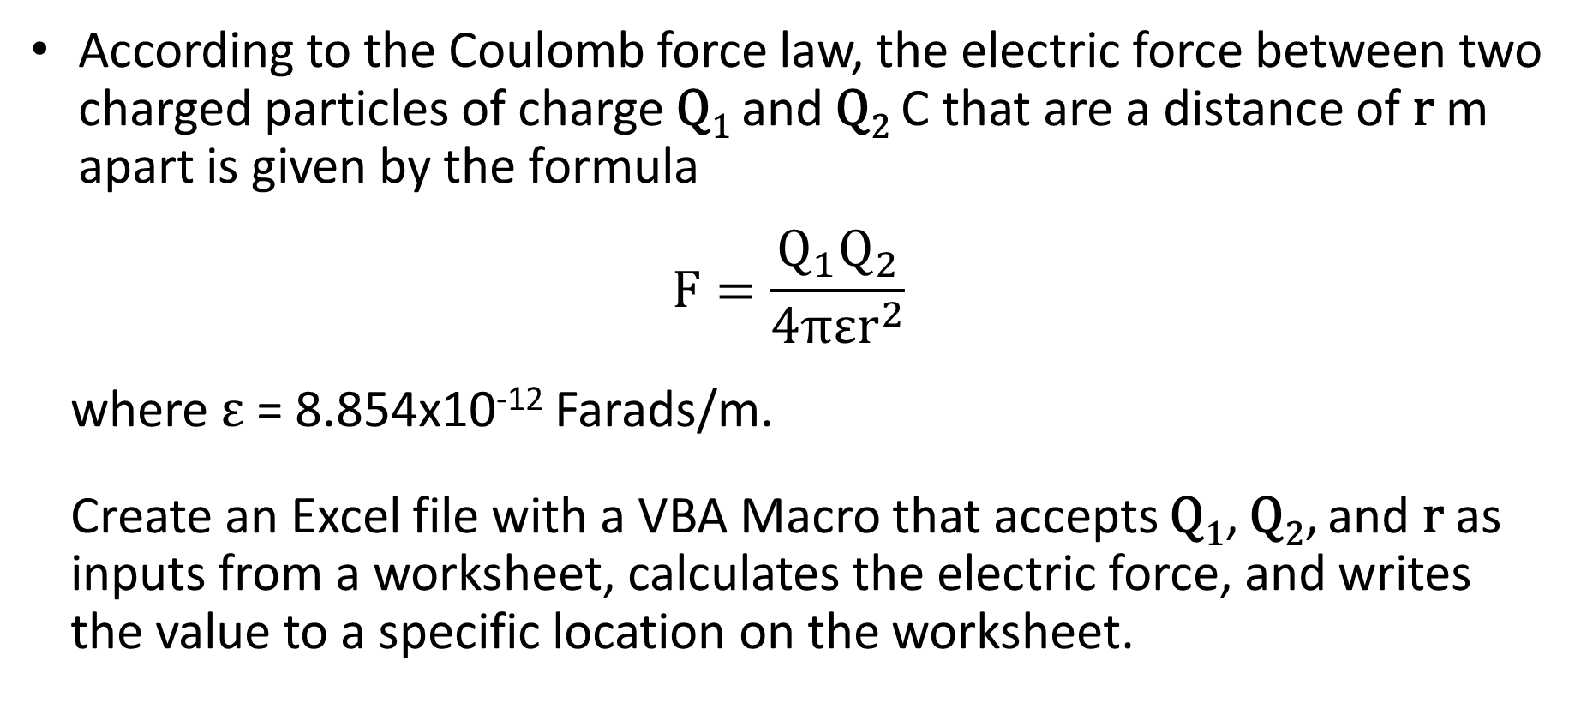
Example
According to the Coulomb force law, the electric force between two charged particles of charge Q₁ and Q₂ C that are a distance of r m apart is given by the formula
$$F=\frac{Q_{1}Q_{2}}{4πεr^{2}}$$
where ε = 8.854x10⁻¹² Farads/m.
Create an Excel file with a VBA Macro that accepts Q₁, Q₂, and r as inputs from a worksheet, calculates the electric force, and writes the value to a specific location on the worksheet.

Slide 14



Please download and install the Slido app on all computers you use
Without writing any code, what data type should Q1, Q2, r, and F be?
ⓘ Start presenting to display the poll results on this slide.

Slide 15
Please download and install the Slido app on all computers you use
How might we get the input value of Q2?
ⓘ Start presenting to display the poll results on this slide.

Slide 16
Please download and install the Slido app on all computers you use
How might we output the value of F?
ⓘ Start presenting to display the poll results on this slide.

